Slide 1
TS-EAS
This meeting is being recorded!
Tuesday 7th of October
6am PST / 7am MST / 8am CST / 9am EST/ 1 pm UTC / 2pm BST / 3pm CEST / 4pm EEST / 6:30pm IST / 9pm CST / 11pm AEDT

Slide 2
Karin and Mary: Welcome

Slide 3
Rebecca: Notes

Slide 4
Karin: Membership and introductions
PHOTO TIME!!!!!

Slide 5
Some members are leaving
Left by July/August 2025
Lara Michaels (Standards Committee liaison)
Lydia Tang (Council liaison)
Megan Mummy (Collection Management Section liaison to Outreach)

Slide 6

Thank you for your service!

Slide 7
When you introduce yourself
Short intro with name, time zone
Do you get the emails sent to the TS-EAS email list?

Slide 8
Re-appointed members of TS-EAS (3 years)
Mary Samouelian
Kerstin Arnold
Rhys Elia
李彦霖 Yanlin Li

Slide 9
Newest member(s) of TS-EAS
Rebecca Hamburgess
1 year appointment: Early-career member
Yogita Sharma
3 year appointment
Carmela Furio
3 year appointment

Slide 10
Liaison with Standards Committee
Anna Björnsson
John Shamgochian (assistant liaison)
(Dan Michelson, co-chair)

Slide 11
Liaison with Council
Teresa Mora

Slide 12
Liaison for our web pages
Gerhard Müller, EAC webpage
Glenn Gardner, EAD webpage

Slide 13
Liaison to other sections
???, EAS Section (until next August)
Jonathan Kirkwood , Collection Management Section
Liaison to Outreach team

Slide 14
The other members of TS-EAS
Introduction round!

Slide 15
We will now take our new TS-EAS photo!

Slide 16
Karin: Introduction to our different systems to use

Slide 17
Introduction to TS-EAS
Four committee-wide meetings per year
Multiple subteams
https://github.com/SAA-SDT/TS-EAS-subteam-notes/wiki/Sub-Teams-and-Charges#current-standing-sub-teams
Multiple communication formats
Official TS-EAS listserv via SAA
E-mail to TS-EAS forwarded to the co-chairs ( ts-eas@archivists.org )
Google Drive (for working documents)
GitHub (for meeting minutes, schemas, and committee documentation)
Slack (new channel for TS-EAS, should subteams want to use Slack)
Check out the Handbook, particularly https://github.com/SAA-SDT/TS-EAS-subteam-notes/wiki/Meeting-Policies-and-Procedures
Next steps: make sure we have your preferred email address and GitHub user account name. If you do not use GitHub, you can create a free personal account by going here: https://github.com/join

Slide 18
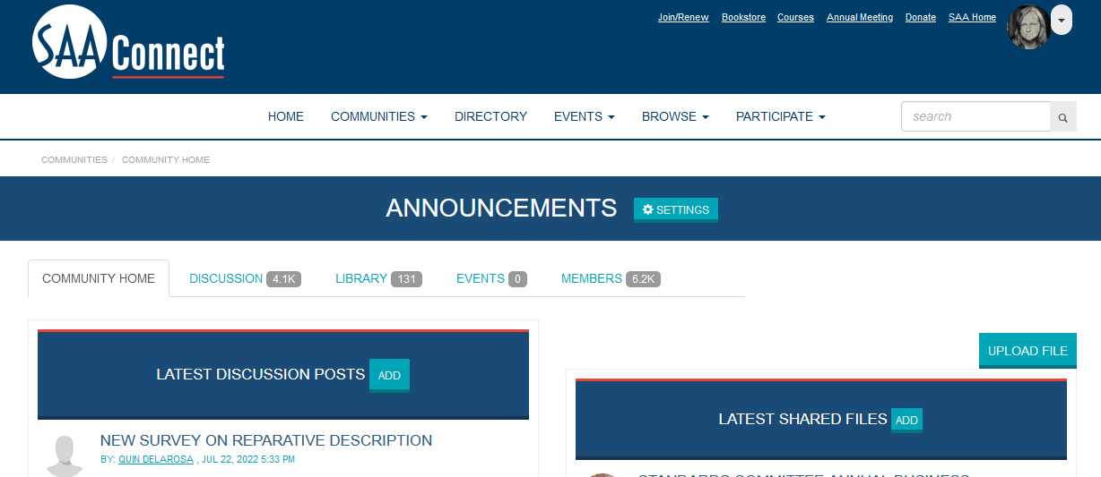
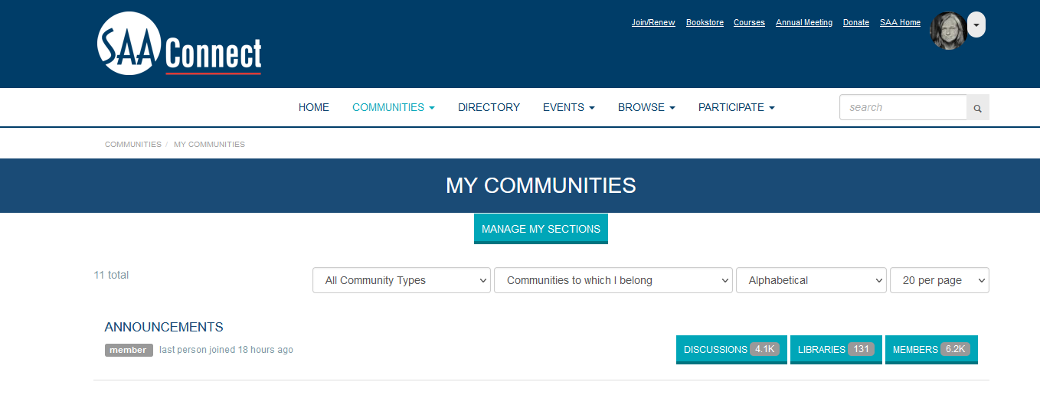
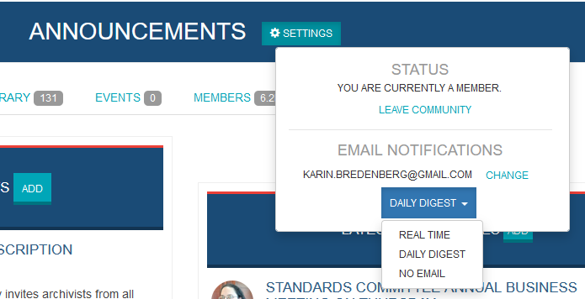
Some controls for the e-mails
https://connect.archivists.org/home
Login with your e-mail

Slide 19
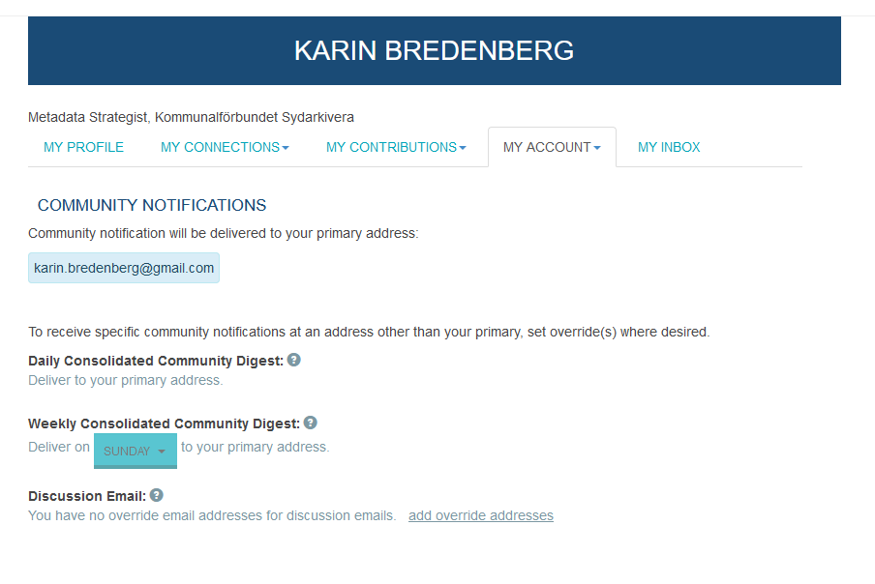
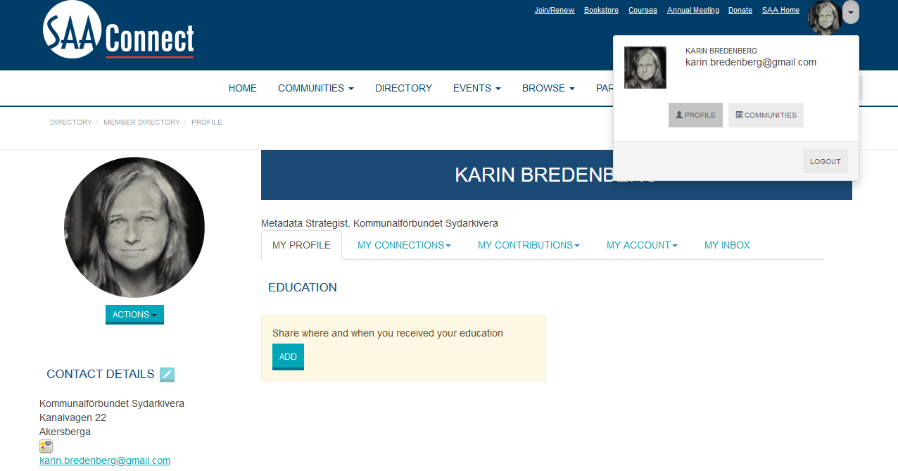
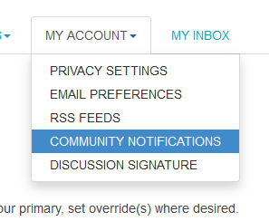
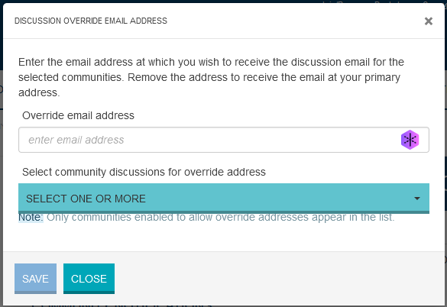
Another e-mail for the e-mails

Slide 20
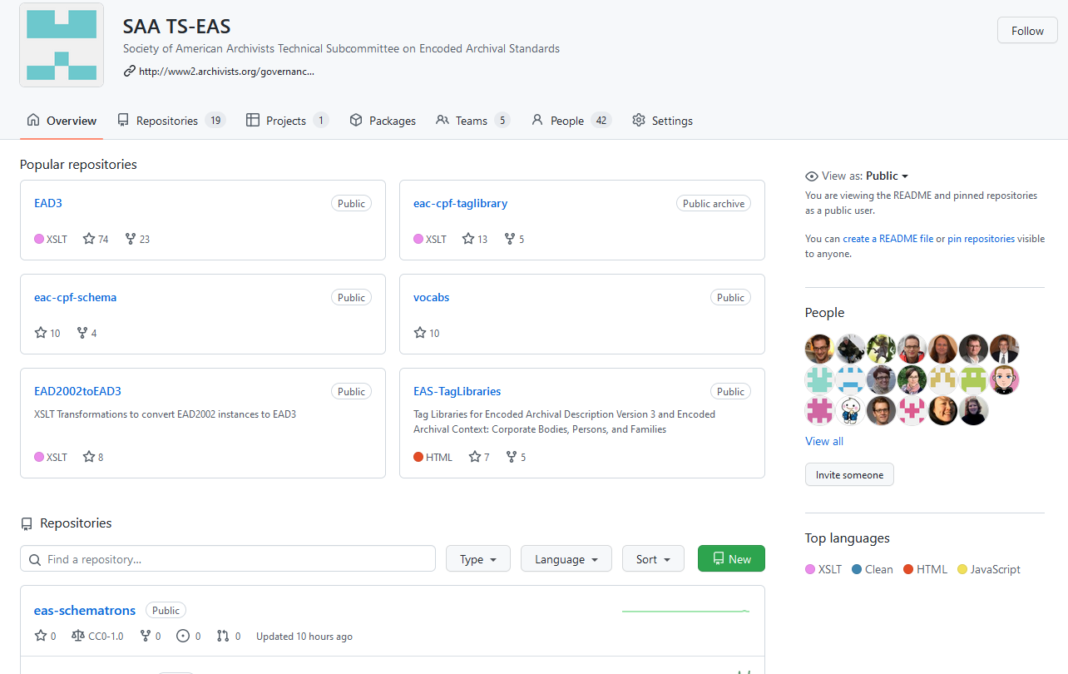
GitHub https://github.com/SAA-SDT
Next steps: make sure we have your preferred email address and GitHub user account name. If you do not use GitHub, you can create a free personal account by going here: https://github.com/join

Slide 21
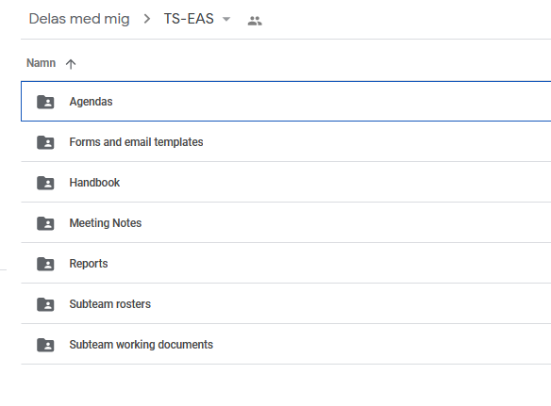
Google Drive
Next steps: make sure we have your preferred email address for Google Drive. You will then be added as a user.

Slide 22
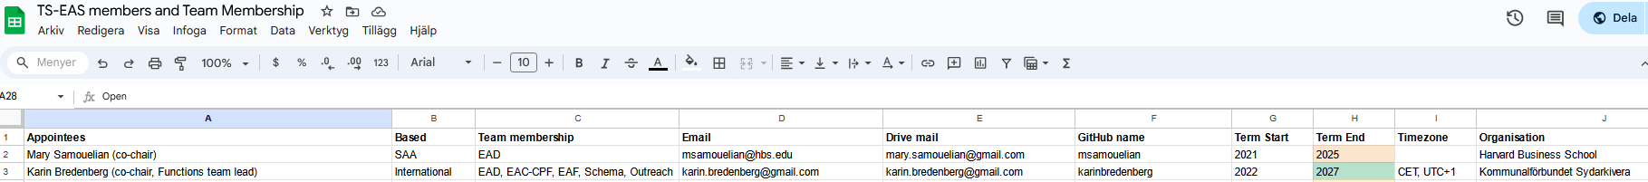
Internal roster list
Do NOT edit any other rows except your own row!!!!!

Slide 23
Links to web pages and email list
EAC-CPF Official Home Page: http://eac.staatsbibliothek-berlin.de/
EAD Official Home Page: http://www.loc.gov/ead/
EAS (EAD/EAC-CPF) Listserv (electronic discussion list) https://listserv.loc.gov/cgi-bin/wa?A0=EAD
EAS (EAD/EAC-CPF) List Subscription Settings http://listserv.loc.gov/cgi-bin/wa?SUBED1=ead&amp;A=1

Slide 24
Updates

Slide 25
Anna: Standards Committee

Slide 26
Standards Committee
New Standards leadership: Dan Michelson and Heather Lember co-chairs

Slide 27
??: EAS Section

Slide 28
EAS Section
No updates from the EAS Section at this time.

Slide 29
Rhys: EAC-CPF

Slide 30
EAC-CPF subteam
Focused on aligning with EAD and EAC-F for the submission.
Next step is creating and collecting examples, particularly how all three work together!
Documentation
https://github.com/SAA-SDT/TS-EAS-subteam-notes/tree/master/eaccpf-subteam
https://eac.staatsbibliothek-berlin.de/

Slide 31
Karin: EAC-F

Slide 32
EAC-F Subteam
Finalisation for the submission is on-going!
Last edits in TL
Notes: https://github.com/SAA-SDT/TS-EAS-subteam-notes/tree/master/functions-subteam/meeting-minutes

Slide 33
Karin (on behalf of Kerstin): EAD

Slide 34
EAD subteam
Current focus on finalising updates to the Tag Library
Review done, transferring review results to GitHub ongoing
Bringing together examples (see more in all-Committee discussion points)
Next steps: continuing work on updated and new pages for the Best Practices Guide
Documentation
https://github.com/SAA-SDT/TS-EAS-subteam-notes/tree/master/ead-subteam
https://www.loc.gov/ead/

Slide 35
Mark: Schema

Slide 36
Schema Subteam
Responsible for creating and maintaining EAS schemas within GitHub
When we regroup, our focus will be on
tidying up the Schematron repository
drafting new migration scripts for EAD4 / EAC-CPF3
All work is structured and visible via GitHub Projects
https://github.com/orgs/SAA-SDT/projects

Slide 37
Cory: Outreach and Communications

Slide 38
Outreach Subteam
Responsible for sharing information about TS-EAS work and standards
Expanded group membership finalized for current term
Brainstorming meeting held in September
Initial focus on community survey for Fall 2025
Developing outreach plan for research in Winter/Spring 2026
Available for collaborations with other teams

Slide 39
Full committee discussion points or updates

Slide 40
Updates
Co-chairs

Slide 41
Updates
Call for members
Standards will be able to report in that for TS EAS:
7 reappointments and 1 new SAA and 3 new international is needed
If your period is ending in 2026 we (Karin and Mary) will contact you!
Do you want to continue?
We need to know ASAP!

Slide 42
Updates
When available, TS-EAS co-chairs will be submitting a proposal for a session at the SAA Annual Meeting 2026 with the goal of announcing the approved revisions of EAS!
No request from us co-chairs that you plan to be there!
Annual meeting for TS-EAS 2026 will be as this year on-line before the SAA annual meeting

Slide 43
Submission packet
Karin and Mary

Slide 44
Where we are and where we’re going
First draft of the submission packet will be sent to the Standards Committee by October 17th.
Took a slightly different approach with the document.
Layout and language
Reusing our small working groups result in August
Appendices
TL’s + schema
Other helpful document
Final draft of the submission packet will be sent to the SAA Council by the Standards Committee in time for their February 17-19, 2026 meeting.
Hope to hear soon thereafter of approval!

Slide 45
Examples
The small team

Slide 46
Where examples will be used and how
In the Tag Library
Moving from element-based and attribute-based examples to encoding examples per section within the EAS structure, i.e. <control>, identity section (<identificationData> in EAD), description section (entity and narrative elements in EAD), <relations>
These will be included in the Tag Libraries as an annex with references from the individual elements and attributes
Aim to have a core version (e.g. only mandatory elements, only essential attributes) and an extended version per example
Aim at using the same examples across all EAS when it comes to shared elements and attributes

Slide 47
Where examples will be used and how
In the Best Practices Guide
Keeping the approach of providing element and attribute encoding examples in context, illustrating potential alternative encoding approaches as applicable
Could be extended by encoding examples provided by the community (which would be marked as such for provenance transparency)

Slide 48
GitHub
Mark

Slide 49
Any other business items?
All

Slide 50
All TS-EAS!
Next all TS-EAS meeting:
February (aim: time better for members in the timezones with more than +5 from GMT)
May
SAA Annual Meeting
October

Slide 51
We will now take one extra TS-EAS photo!

